Slide 1

Azure Developer – Virtual Mentored Program
Azure Data Fundamentals, Azure Event Hub, & Azure Key Vault

Slide 2
Week 4 Content
Azure Data Fundamentals
Azure Event Hub
Azure Key Vault

Slide 3
Azure Data Fundamentals

Slide 4
Data Services Available in Azure
Multiple services available in Azure for persisting, managing, and accessing data
Have already looked at a few, including Azure SQL, Azure Cosmos DB, Azure PostgreSQL, and Azure Storage
The previous services reviewed are often used for OLTP (online transactional processing) – e.g., operations for creating a customer, submitting a new online order, etc.
Other services provide OLAP (online analytical processing) capabilities for big data management and intelligence gathering from the data

Slide 5
Data Management

Slide 6
Data Management – Stages
Ingestion
Scrubbing & Normalization
Aggregation
Analysis & Intelligence Gathering

Slide 7
Data Ingestion
Could be via message exchange or streaming
Depending on size/scope, may translate to LARGE amounts of incoming data
Ingestion
Scrubbing & Normalization
Aggregation
Analysis & Intelligence Gathering

Slide 8
Data Ingestion
Because of potential scale, bandwidth may be a concern
Depending on application, latency may also be a concern
Data may require translation (e.g., from low-level bytes to object or JSON, from one schema to another)
Ingestion
Scrubbing & Normalization
Aggregation
Analysis & Intelligence Gathering
Notes:
Medical info, autonomous vehicles, streaming data may be less tolerant of latency issues

Slide 9
Data Ingestion
Event hubs or streaming analytics platforms support ingestion at scale
Provide time and context-aware processing for correct sequencing
Data may flow through intermediate storage on way to final processing
Depending on sensitivity of data, could require robust security at each stop
Ingestion
Scrubbing & Normalization
Aggregation
Analysis & Intelligence Gathering

Slide 10
Data Scrubbing & Normalization
Depending on payload, some portions of the data may not be needed
Or some portions might contain sensitive detail
Those parts not needed or sensitive can be “scrubbed” to exclude
Ingestion
Scrubbing & Normalization
Aggregation
Analysis & Intelligence Gathering

Slide 11
Data Scrubbing & Normalization
Represents another potential optimization that can preserve storage
In other cases, similar data may be coming in multiple, disparate formats
For example, 2 different temperature sensors both providing temp/humidity detail
Or similar detail may be received from two different partners in different formats
Ingestion
Scrubbing & Normalization
Aggregation
Analysis & Intelligence Gathering

Slide 12
Data Scrubbing & Normalization
Normalization can bring consistency to the disparate content
By normalizing, becomes a single dataset for comprehensive analysis
Normalization may happen as part of ingestion or as part of a separate step
Ingestion
Scrubbing & Normalization
Aggregation
Analysis & Intelligence Gathering
Notes:
Temperature/humidity is temp/humidity – regardless of the device and how the device communicates it
Taking two different formats of partner information and normalizing it to a common schema

Slide 13
Data Aggregation
Helps provide full picture of data from multiple streams
May also be used to enrich with info from other data sources
Data will be stored in persistent storage for downstream analysis & reporting
Ingestion
Scrubbing & Normalization
Aggregation
Analysis & Intelligence Gathering

Slide 14
Data Aggregation
In statistical analysis, the larger the sample size, the more accurate the inference
To manage costs, large sets of data may leverage different types of storage:
Hot storage – most recent data and most relevant for current analysis
Cool storage – data not actively used but potentially relevant (short-term trends)
Cold or archive storage – data kept for historical purposes and long-term trending
Security of the stored data and encryption at rest become critical
Ingestion
Scrubbing & Normalization
Aggregation
Analysis & Intelligence Gathering

Slide 15
Data Analysis & Intelligence Gathering
In the digital age, data is the competitive edge
Companies that manage their data as a critical asset succeed
Keys:
Aggregating efficiently
Analyzing effectively
Ingestion
Scrubbing & Normalization
Aggregation
Analysis & Intelligence Gathering

Slide 16
Data Analysis & Intelligence Gathering
Goal is to identify and leverage the most important data points
Importance is measured by business value-driven decision-making
What can I learn about today’s customers, scenarios, or business cases?
What can I effectively predict about tomorrows?
Ingestion
Scrubbing & Normalization
Aggregation
Analysis & Intelligence Gathering

Slide 17
Data Analysis & Intelligence Gathering
Scenario: Temperature sensors have been steadily recording and aggregating readings from a high-profile data center for a major bank. Initially, the intent was to support being reactive – enabling staff to adjust when an alert was received about an excessively high or low reading (since it can lead to equipment damage or malfunction). Going forward, leadership would like to investigate coupling historical data with current data to understand what kind of proactive intelligence can be gained.
What kinds of intelligence do think could be gleaned from this data?
How might the company leverage the information in a more proactive manner?
What other kinds of information could the data be enriched with to provide more comprehensive value and decisioning?
Ingestion
Scrubbing & Normalization
Aggregation
Analysis & Intelligence Gathering
Notes:
What kinds of things do you think could be learned from this data? What are some ideas for how it might be used proactively? Can it be coupled with other information (enriched) to increase its value?

Slide 18
Data Analysis & Intelligence Gathering
Requires balancing of competing concerns:
To increase quality of intelligence, more data is required (sometimes MUCH more)
But massive datasets can be complex to manage and process
Ingestion
Scrubbing & Normalization
Aggregation
Analysis & Intelligence Gathering

Slide 19
Data Analysis & Intelligence Gathering
Enter ML / AI:
Algorithms are used to build mathematical models from existing data
Results in a mathematical “trajectory” (and confidence level)
Algorithms can be configured to learn and improve over time
Hyperscale available in the Cloud brings near-limitless power to bear
Ingestion
Scrubbing & Normalization
Aggregation
Analysis & Intelligence Gathering

Slide 20
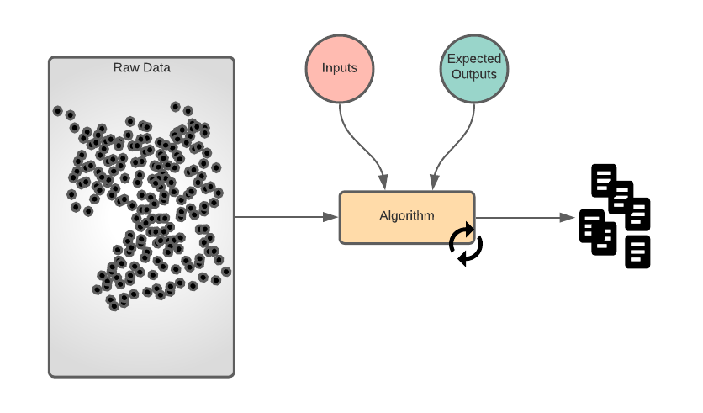
Supervised Learning
Ingestion
Scrubbing & Normalization
Aggregation
Analysis & Intelligence Gathering
Notes:
Refresher

Slide 21
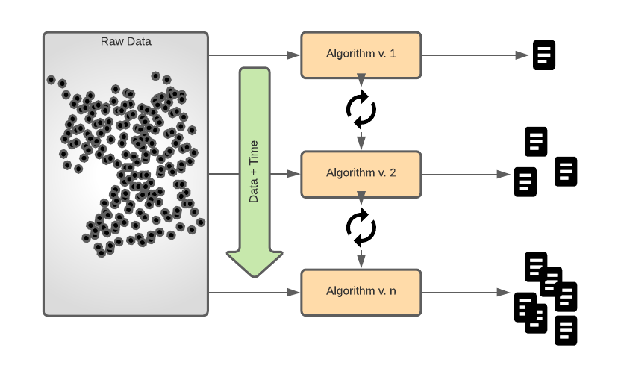
Unsupervised Learning
Ingestion
Scrubbing & Normalization
Aggregation
Analysis & Intelligence Gathering
Notes:
Refresher

Slide 22
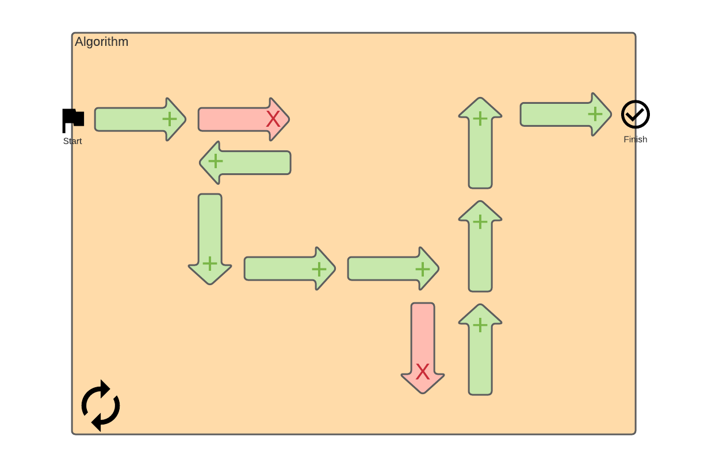
Reinforcement Learning
Ingestion
Scrubbing & Normalization
Aggregation
Analysis & Intelligence Gathering
Notes:
Refresher

Slide 23
Azure Data Factory
Facilitates management and usage of “big data” (large amounts of data, potentially coming from multiple locations in multiple formats)
Goal is to move from “raw” data to data intelligence
Azure Data Factory provides a managed service supporting:
Complex hybrid ETL (extract-transform-load)
ELT (extract-load-transform)
General data integration
Often combined with several other Azure data tools to create pipelines for data movement

Slide 24
Azure Data Factory
Bring together data from multiple, disparate sources (both on-prem & Cloud)
Multiple connectors available to facilitate
Connect & Collect
Mapping data flows provide access to Spark-enabled data transformation graphs
Can include aggregation with other logic/data
Transform & Enrich
CI/CD support for automating deployment of pipelines
Supports incremental publish (while developing)
CI/CD & Publish
Observability required to ensure pipelines remain healthy
Integrates with Azure Monitor and supports automated access for dashboarding
Monitor
Source: https://docs.microsoft.com/en-us/azure/data-factory/introduction

Slide 25
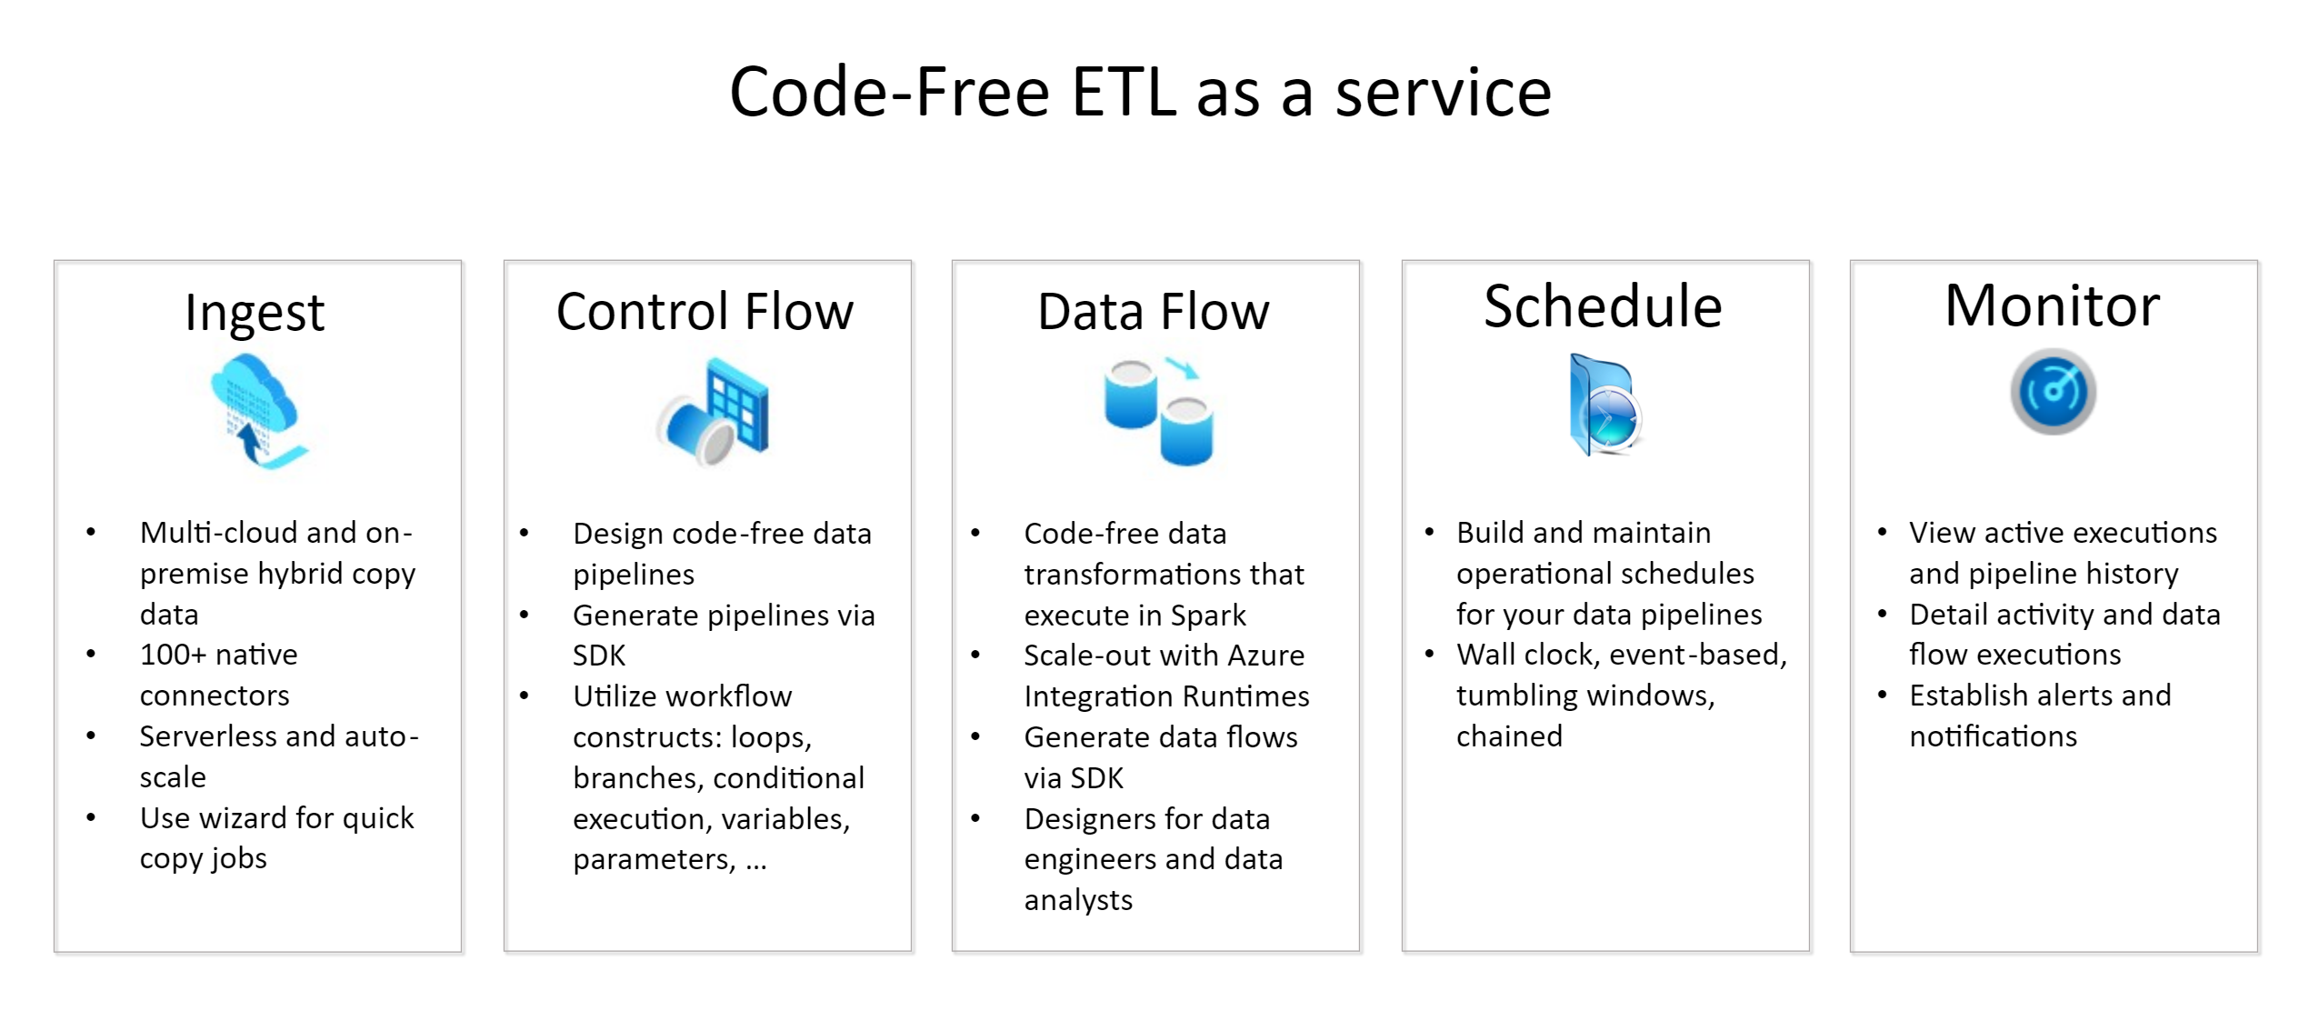
Azure Data Factory
Source: https://docs.microsoft.com/en-us/azure/data-factory/introduction
Notes:
Pipelines – Logical grouping of activities performing a unit of work
Activities – Processing step in a pipeline
Datasets – Data structures within the data stores
Linked services – Similar to connection string; defines connectivity to the data source (e.g., SQL Server DB, Storage Account, etc.). Can include data sources and compute resources (for execution transformations)
Integration Runtimes – Provides bridge between activity and linked services; provides compute environment for execution of activity minimizing latency and accounting for security
Triggers – Processing unit that determines when the pipeline should execute
Pipeline runs support things like parameters, control flow, and variables

Slide 26
Azure Data Factory
Demo
Notes:
https://docs.microsoft.com/en-us/azure/data-factory/tutorial-hybrid-copy-data-tool
Copy data from a SQL Server database to Azure Blob storage by using the Copy Data tool

Slide 27
Azure Synapse Analytics
Provides data warehousing in the Cloud
Robustly supports capabilities that bring together powerful data retrieval with powerful analytics for gaining intelligence from the data
Built for integration with Machine Learning and data visualization

Slide 28
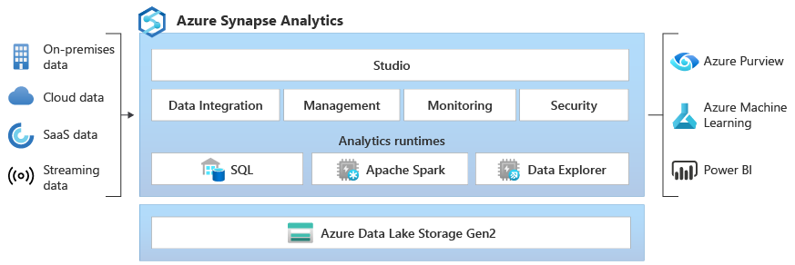
Azure Synapse Analytics
Source: https://docs.microsoft.com/en-us/azure/synapse-analytics/overview-what-is

Slide 29
Azure Synapse Analytics
Demo
Notes:
https://docs.microsoft.com/en-us/azure/synapse-analytics/get-started – Execute steps 1, 2, 3, 4, 6, 7
Get Started with Azure Synapse Analytics

Slide 30
(Some) Other Available Services
Provides powerful data analytics platform in the Cloud
Offers 3 environments: SQL, Data Science & Engineering, and ML
Azure Databricks
Managed access to several open-source frameworks used for data analytics
Supports multiple types of clusters
Azure HDInsight
Fully managed stream processing engine
Built to performantly process very large amounts of streaming data
Used with IoT (Internet of Things) solutions
Azure Stream Analytics
Notes:
Databricks
Databricks SQL – supports SQL queries against data lake; can be used to create visualizations and dashboards
Databricks Data Science & Engineering – provides interactive workspace where data engineers, data scientists, and ML engineers can collaborate; source data can be ingested via Azure Data Factory or streamed near real-time using technologies like Azure Event Hub (which will talk about in a little bit)
Databricks Machine Learning – integrated, E2E ML environment that provides managed services for model training, feature management, and feature/model serving
HDInsight – multiple types of clusters: Apache Hadoop, Apache Spark, Apache Kafka, etc.

Slide 31
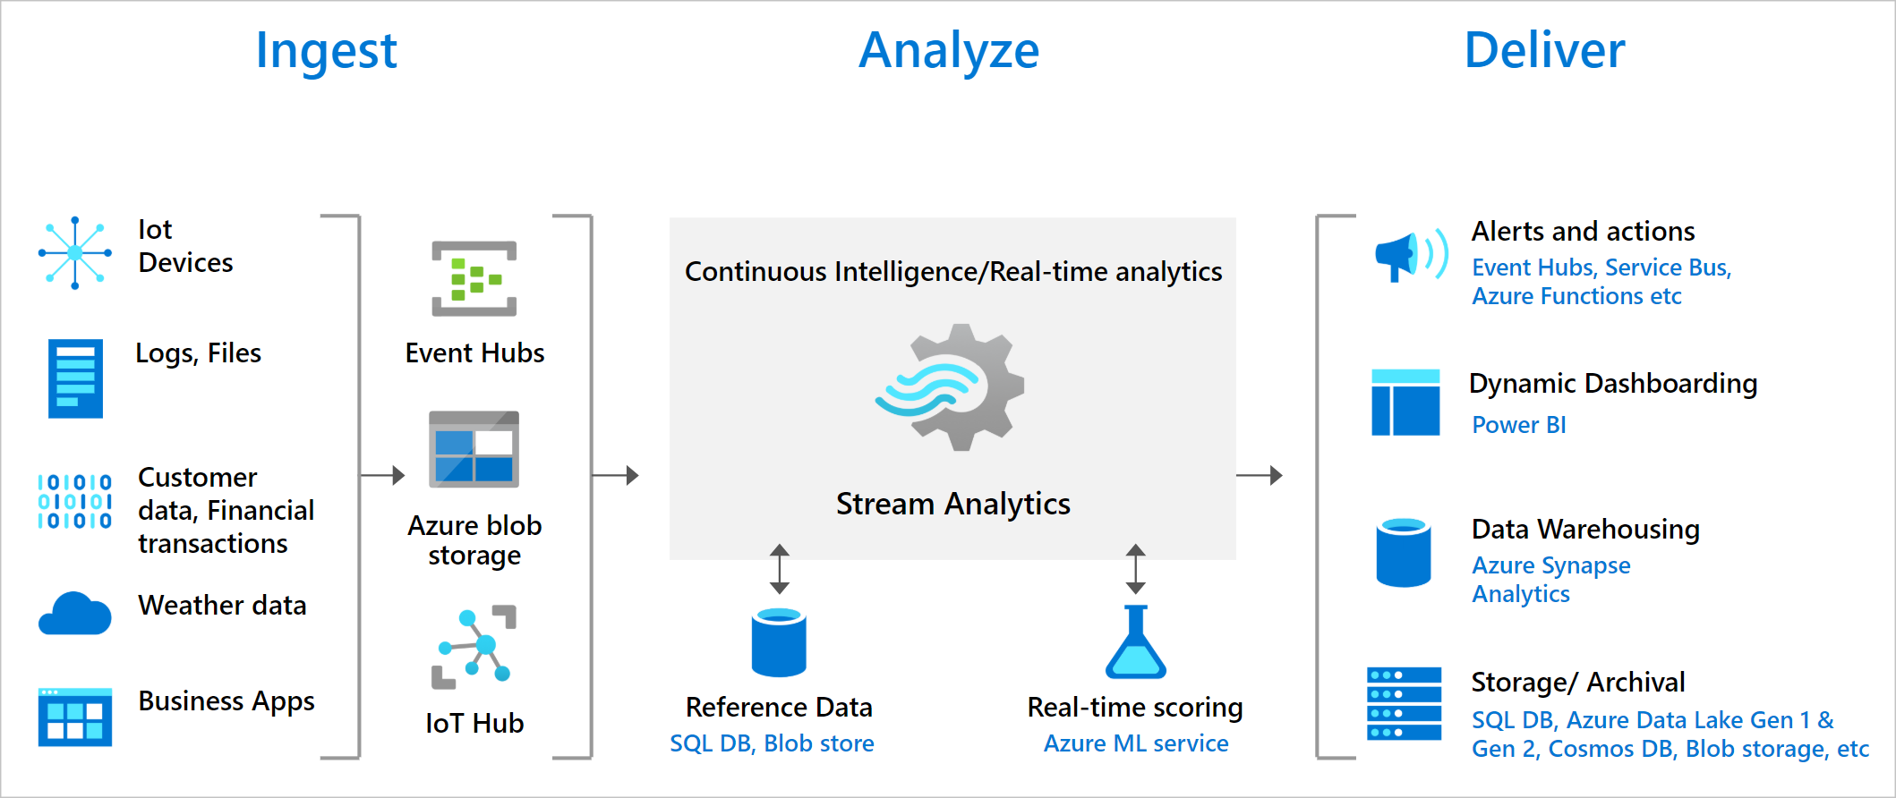
Azure Stream Analytics
Source: https://docs.microsoft.com/en-us/azure/stream-analytics/stream-analytics-introduction
Notes:
Operates using concept of Tumbling Windows for timing – allows reading of data in fixed increments to enable analysis of “blocks” of incoming data in a specific window of time; concept is built into the Stream Analytics query language
Review Connected & Cloud-Based Architecture: Lucidchart for example of a ref arch

Slide 32
Azure Event Hub

Slide 33
Azure Event Hub
Fully managed service supporting data streaming and event ingestion
Built to process millions of events per second
Event-based architectures can provide a couple of different advantages:
Loose coupling between systems
“Freeing” the data
Supports real-time (or near real-time) and batch processing
Notes:
Events are things of interest that happened (past tense) – e.g., customer updated, account updated, order changed

Slide 34
Azure Event Hub
Sits between event producers and event consumers (aka event ingestion)
Producers “push” (or produce) events to a topic on the Event Hub
One or more consumers can subscribe to that topic to be notified when a new message hits
Data included in the message can be used by the consumer to decide what to do with the information (based on where it fits into the consumer’s workflow)

Slide 35
Azure Event Hub
Common use cases include:
Transaction processing
User/device telemetry (data about activity)
Logging
Analytics pipelines including clickstreams (for recording detail about user activities across the pages of a site)
Provides storage and retention for event detail
Supports retry/replay if needed – means producer and consumers don’t need to be online at the same time (benefit of looser coupling)
Partitioning of topics helps organize incoming information and helps boost performance when retrieving event detail

Slide 36
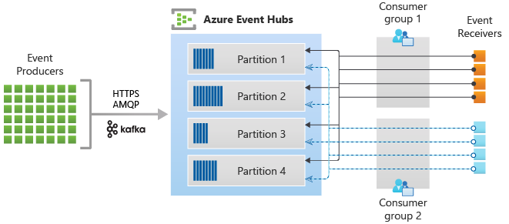
Azure Event Hub
Source: https://docs.microsoft.com/en-us/azure/event-hubs/event-hubs-about
Notes:
Event Hubs contains the following key components:
Event producers: Any entity that sends data to an event hub. Event publishers can publish events using HTTPS or AMQP 1.0 or Apache Kafka (1.0 and above)
Partitions: Each consumer only reads a specific subset, or partition, of the message stream.
Consumer groups: A view (state, position, or offset) of an entire event hub. Consumer groups enable consuming applications to each have a separate view of the event stream. They read the stream independently at their own pace and with their own offsets.
Throughput units (standard tier) or processing units (premium tier) or capacity units (dedicated) : Pre-purchased units of capacity that control the throughput capacity of Event Hubs.
Event receivers: Any entity that reads event data from an event hub. All Event Hubs consumers connect via the AMQP 1.0 session. The Event Hubs service delivers events through a session as they become available. All Kafka consumers connect via the Kafka protocol 1.0 and later.

Slide 37
Azure Event Hub
Lab
Notes:
https://docs.microsoft.com/en-us/azure/event-hubs/event-hubs-dotnet-standard-getstarted-send
Send events to and receive events from Azure Event Hubs - .NET (Azure.Messaging.EventHubs)
https://docs.microsoft.com/en-us/azure/event-hubs/event-hubs-java-get-started-send
Use Java to send events to or receive events from Azure Event Hubs (azure-messaging-eventhubs)
https://docs.microsoft.com/en-us/azure/event-hubs/event-hubs-python-get-started-send
Send events to or receive events from event hubs by using Python (azure-eventhub)

Slide 38
Azure Key Vault

Slide 39
Azure Key Vault
Securely store and tightly control tokens, passwords, API keys, etc.
Can also be used to store/manage sensitive application config detail (like Connection Strings)
Secrets Management
Provides secure storage, management, and access for keys used to encrypt (and decrypt) data
Key unlocks sensitive information so protection is critical
Key Management
Supports provision, management, and deployment for public/private certs used to secure workloads
Certificate Management
Notes:
Provides secure management for sensitive data needed to configure and define our application workflows

Slide 40
Azure Key Vault
Comes in two “flavors”
Standard – encrypts with a software key
Premium – secures data using Hardware Security Module (HSM)-protected keys; more secure but also costlier
Supports API integration for pulling a secret into a runtime workflow
Also, multiple other Azure services have direct integration with Key Vault built in so that you can easily apply as part of service execution/operation
Also, can be easily integrated with CI/CD pipelines in Jenkins, GitHub Actions, and Azure DevOps
Notes:
For CI/CD integration, often there will be a predefined “function” in the CI/CD platform that facilitates this integration; if not there, still have access to API-based integration

Slide 41
Azure Key Vault
Some of the high-level benefits include:
Centralization of sensitive detail needed to configure and operate your workloads
Granular security, allowing admin to control access through Azure Active Directory and Role-Based Access Control (RBAC)
Provides robust monitoring capabilities so an organization can see and know who is accessing and how
As previously mentioned, integrates seamlessly with other Azure services (e.g., encryption for Azure Disks, sophisticated encryption support in Azure SQL, and secure configuration for Azure App Service)
Notes:
Able to control the various types of operations that an identity can perform against each type of sensitive detail (list, read, change, delete, etc.)

Slide 42
Azure Key Vault
Demo
Notes:
https://docs.microsoft.com/en-us/azure/key-vault/general/tutorial-net-create-vault-azure-web-app
Tutorial: Use a managed identity to connect Key Vault to an Azure web app in .NET

Slide 43




Best of luck as you forge ahead on your Cloud journey!

